Slide 1
Vaccine Side
Effects
Team 6 : 109090023 科管24 甘倍菁
109090035 科管24 陳佑祥
109091012 科管24 林芝安

Slide 2
Agenda
Problem
Identification
Sources &
Collection
Framework of
Techniques
Methodology
Results
Conclusion &
Next Step
References

Slide 3
1
Problem Identification

Slide 4
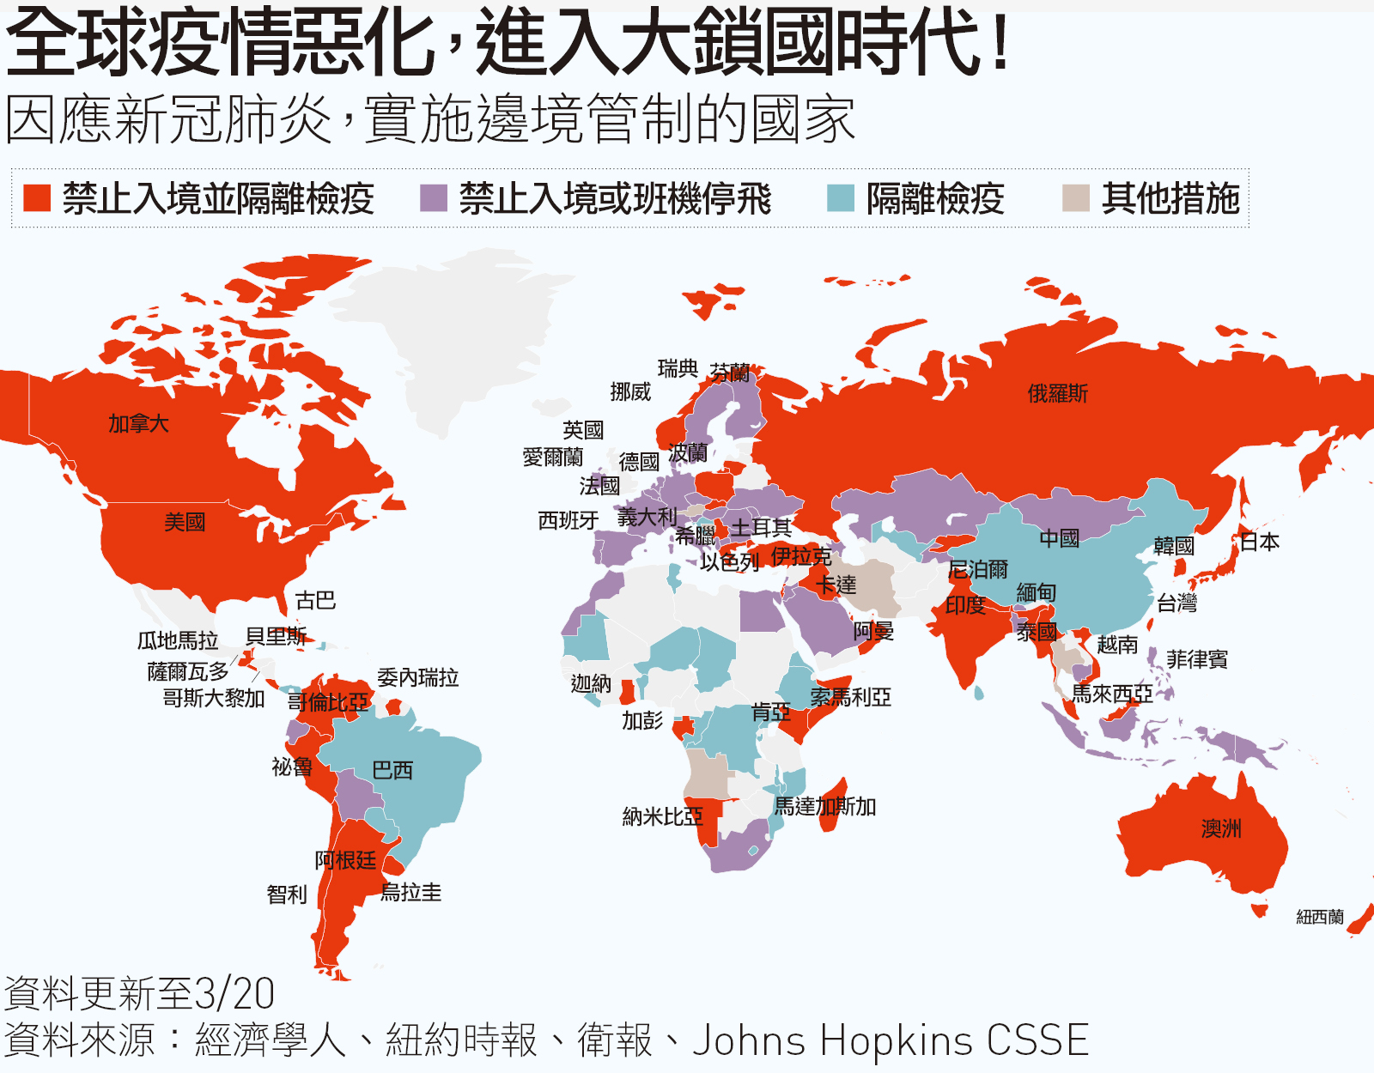
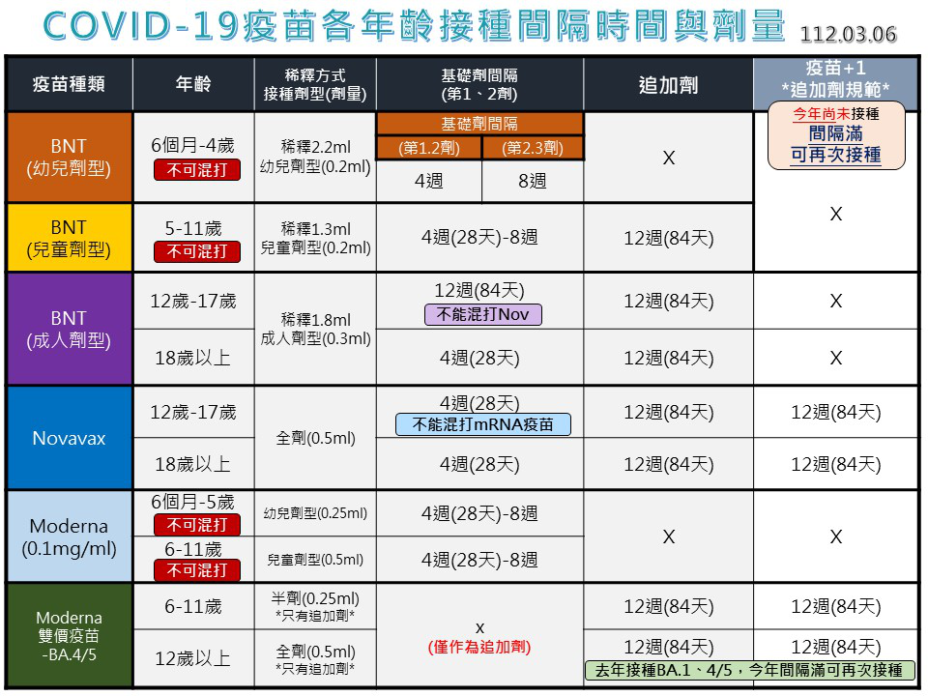
Background
Global pandemic of coronavirus disease
Reduce the risk of infection

Slide 5
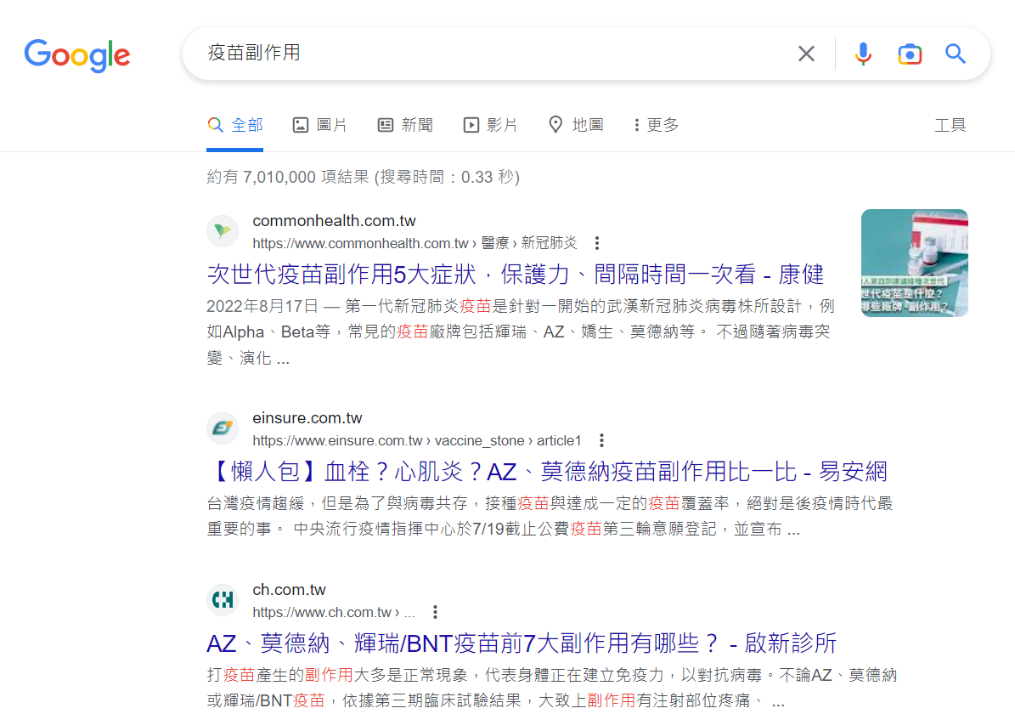
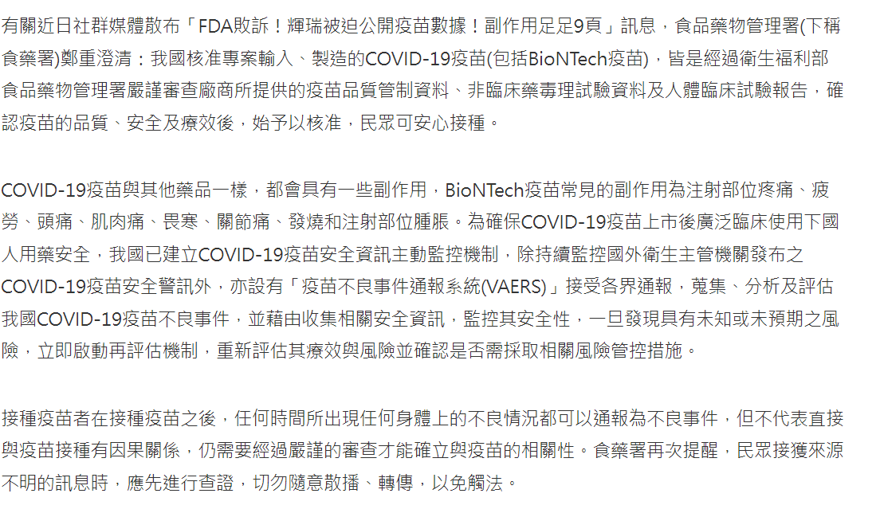
Identification
Many sides affect comments making difficult to decide which to inoculate
→ Provide a reliable rating system for COVID-19 vaccines that can help guide individuals in making informed decisions regarding vaccination
Many words making difficult to quickly get key point
→ Visualize keywords for people easily to reading

Slide 6
2
Data Sources & Collection

Slide 7


Data Sources
Dcard is a Taiwanese online community platform that mainly caters to university students and young people.
It provides a platform for communication and sharing in various aspects such as learning, life, and entertainment.
PTT is one of the oldest and largest forums in Taiwan. It is known for its broad range of discussion topics, including technology, politics, entertainment, travel, education, and more.
PTT has a simple and easy-to-use interface and is entirely free to use. Users can create accounts and post comments or start new threads in various categories.

Slide 8
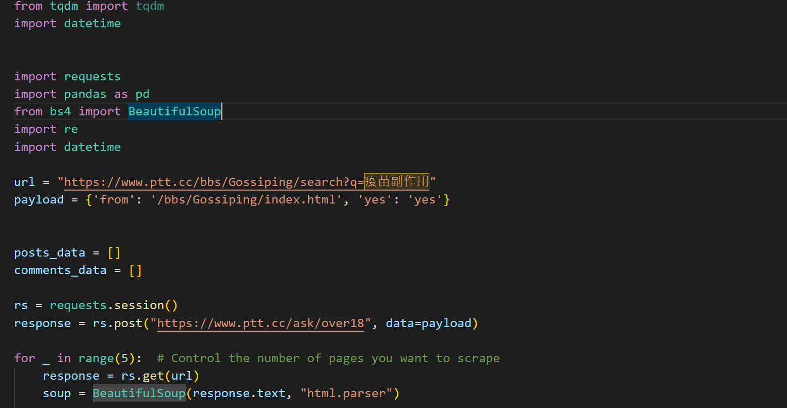
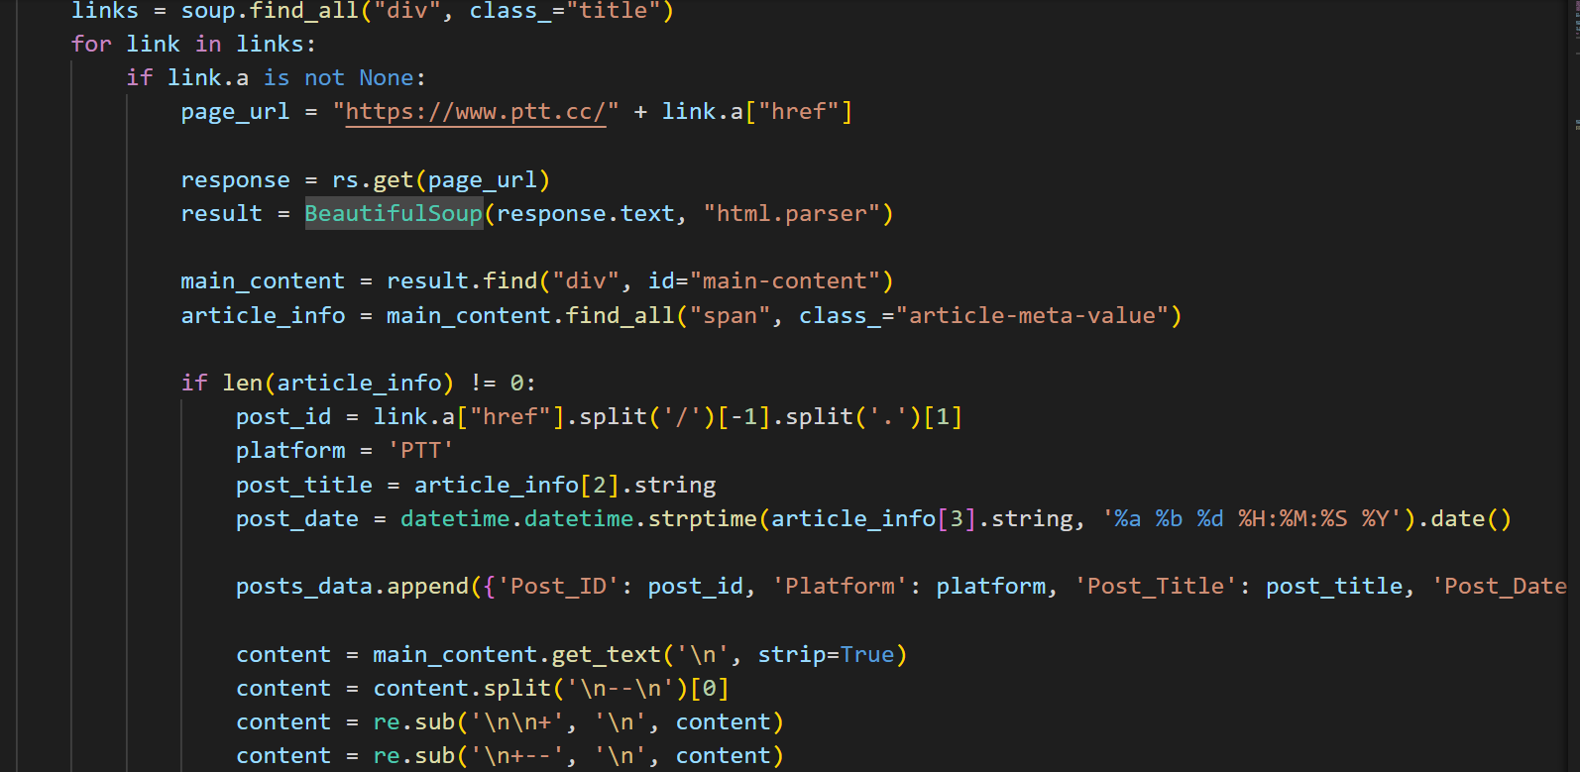
Data Collection

Slide 9
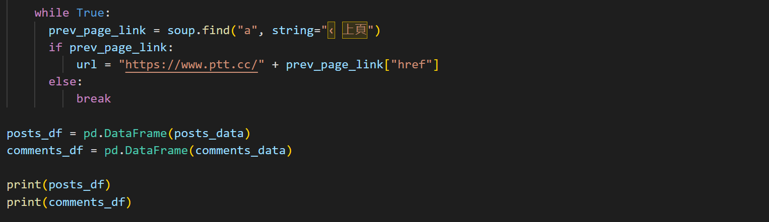
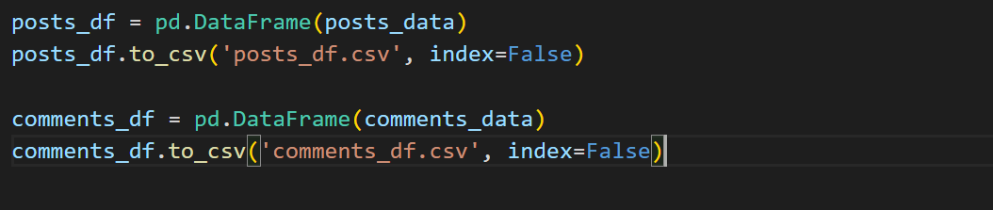
Data Collection

Slide 10
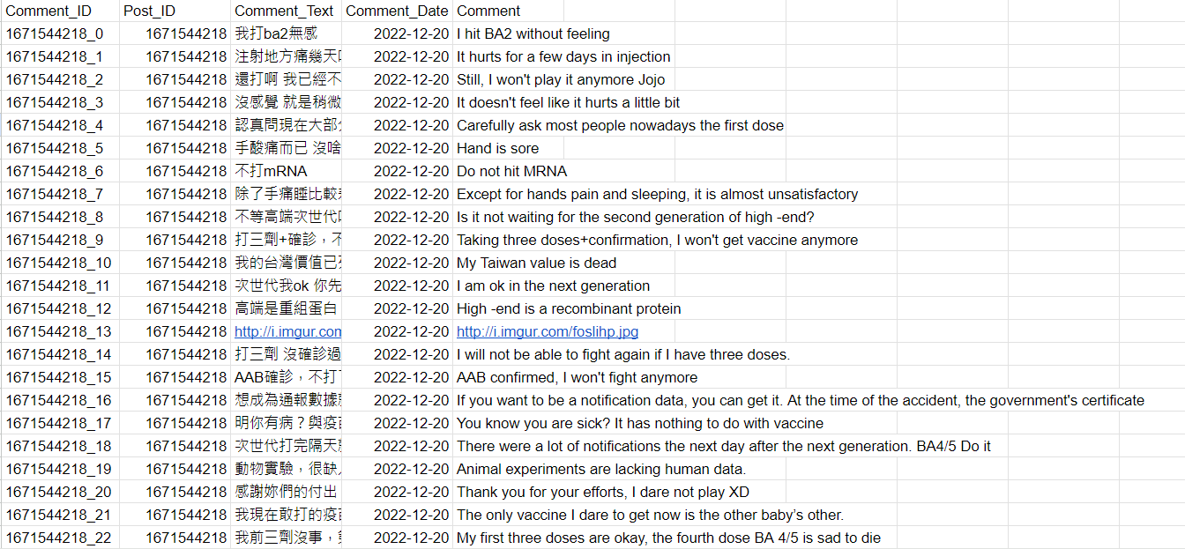
Data Collection
Tatal 1063 Comments
Link: https://docs.google.com/spreadsheets/d/15fyeQF11dBPmDXlr2eSresujJ9SRAlHGd3-TC-MkLmQ/edit?usp=sharing

Slide 11
3
Framework of
Techniques

Slide 12
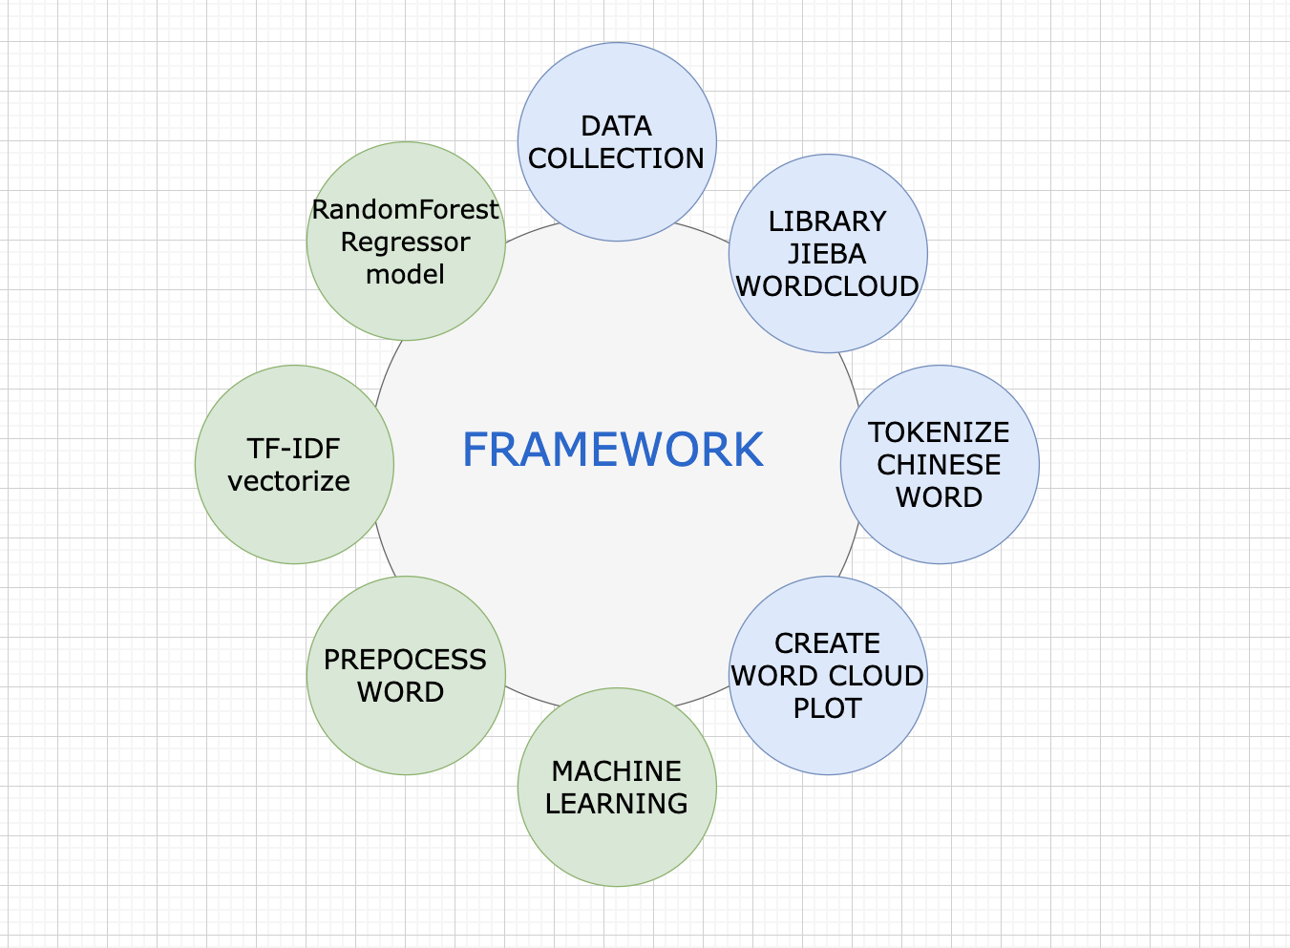
Framework of techniques
Notes:
Word Cloud
Describe the process of generating the word cloud, including data collection, text preprocessing (removing stop words, tokenization, etc.), and visualization.
Show examples of word clouds generated from your project and discuss the insights they provide.
Machine Learning for Predicting Popular Brand Vaccines
Explain the purpose of this component and its relevance to the project.
Describe the machine learning model(s) used, including the algorithms, features, and target variable.
Discuss the process of training, validating, and testing the model, as well as any performance metrics used (e.g., accuracy, precision, recall, F1-score).
Present the results of the model and their implications for predicting popular brand vaccines.

Slide 13
4
Methodology 1- word cloud

Slide 14
Word Cloud
Plotting & Presenting the word cloud
Chinese word Pre-Process data & Tokenizing&removing stopwords
Data Collection
User posts
Comments
Tags
Join the post & comment text
and tokenize word to chinese
Wordcloud
Plt plotting

Slide 15
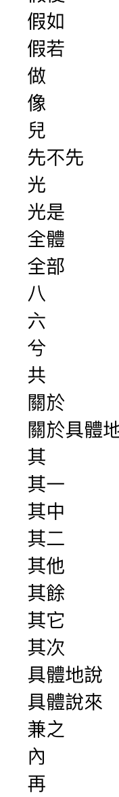
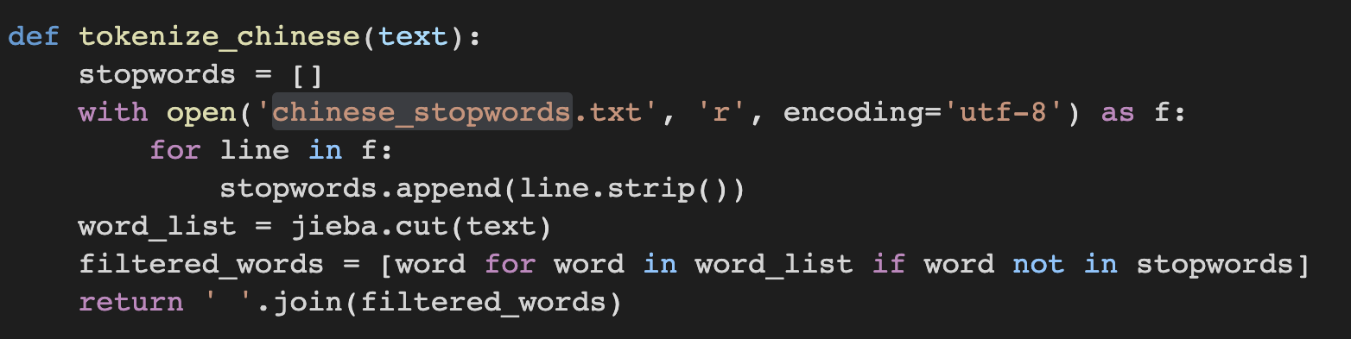
Tokenizing &
Removing chinese stopwords
Since chinese words is very hard to perform normalization , stemming and lemmatization , we only remove the common chinese stopwords in this process.
Some example in chinese stopwords ->

Slide 16
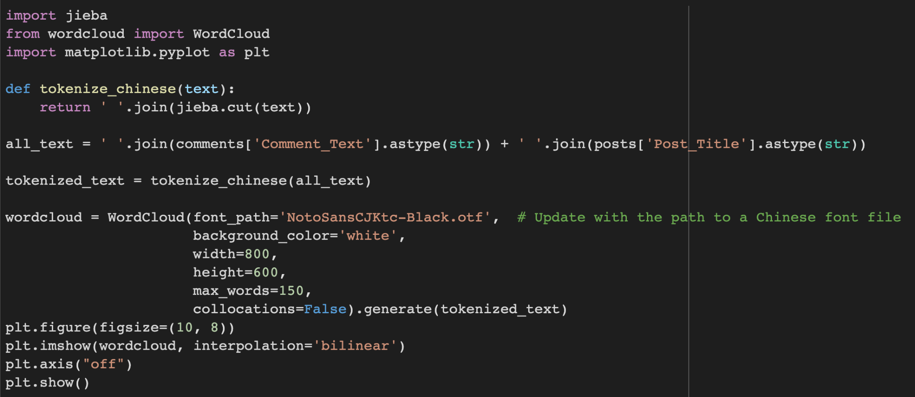
Chinese word Pre-Process data
& Tokenizing
We use jieba for Chinese text tokenization, This function takes the raw text and returns a space-separated string of tokenized words.The raw text from 'Comment_Text' and 'Post_Title' columns is concatenated and tokenized using the tokenize_chinese function.

Slide 17
Plotting & Presenting the word cloud
A word cloud object is created using the Word Cloud function with the specified Chinese font, background color, dimensions, and other parameters.
The word cloud is generated based on the tokenized text using the generate method.
Finally, the word cloud is visualized using matplotlib.pyplot.

Slide 18
4
Methodology 2- what can the word cloud inspire us?

Slide 19
Machine Learning Methodology
To predict which brand in the test day will most people take !!
Train and predict using a random forest classifier
Evaluate and visualize the results
Data Collection
Pre-Process data
& Combine Data
User posts
Comments
Tags
Combine and preprocess data、Generate features using TfidfVectorize
Transform the text data into features using the TfidfVectorizer.
Split the dataset into training (80%) and testing (20%) sets.
Classification, evaluates accuracy using a confusion matrix, and plots the result using a bar chart with axis labels, a title, and a legend

Slide 20
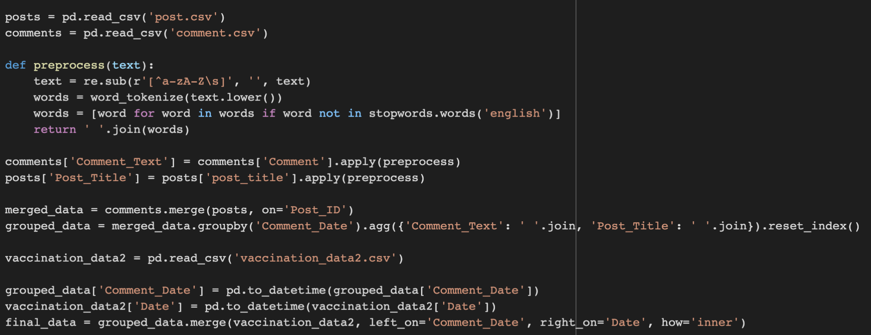
Pre-Process data & Combine Data
First, we preprocess the text by removing any non-alphabetic characters, converting all text to lowercase, and removing any stop words. This is done to clean the text data and make it more manageable for analysis.

Slide 21
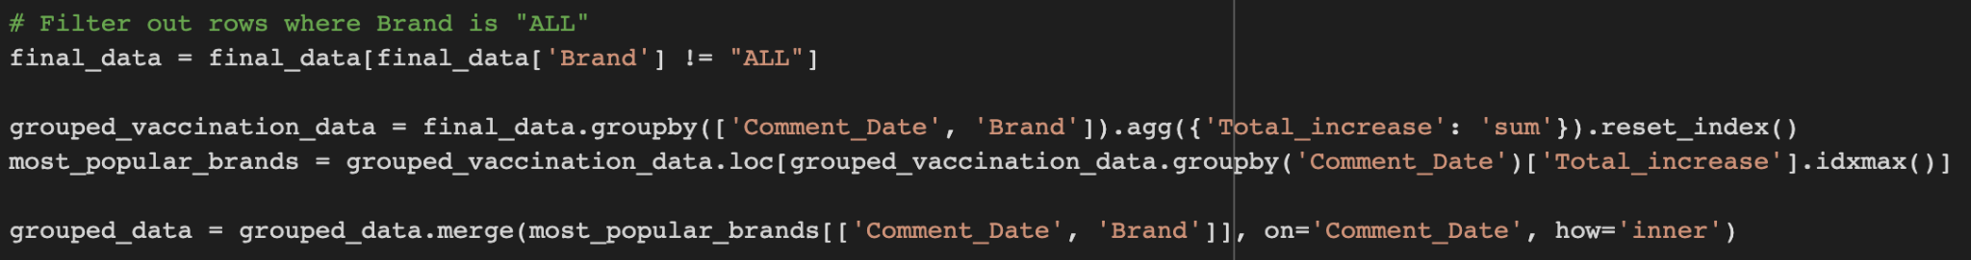
Then, we merge the posts and comments datasets using the 'Post_ID' column, and then we aggregate the text data by 'Comment_Date'. Next, we merge the aggregated text data with the vaccination dataset based on the date.
Filter the dataset to remove rows where the vaccine brand is "ALL". Then group the dataset by Comment_Date and Brand columns and sum up the Total_increase values.

Slide 22
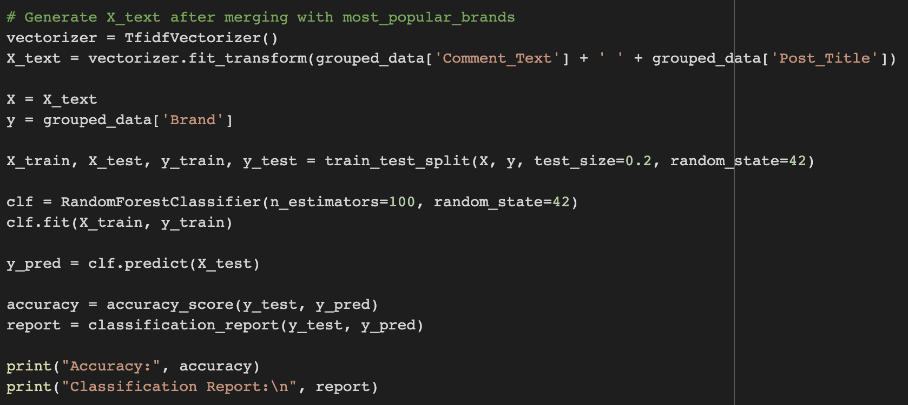
Train and predict using a random forest classifier
STEPS
Generate text features using TfidfVectorizer.
Split the data into training and testing sets.
Fit a random forest classifier on the training data and predict on the testing data.
Calculate the accuracy score and classification report.

Slide 23
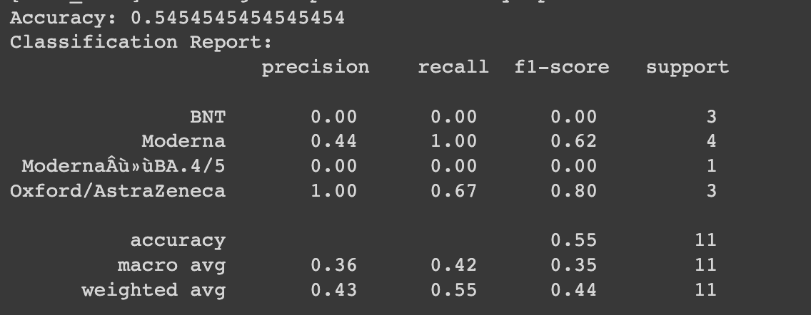
Train and predict using a random forest classifier-Accuracy & Classification Report

Slide 24
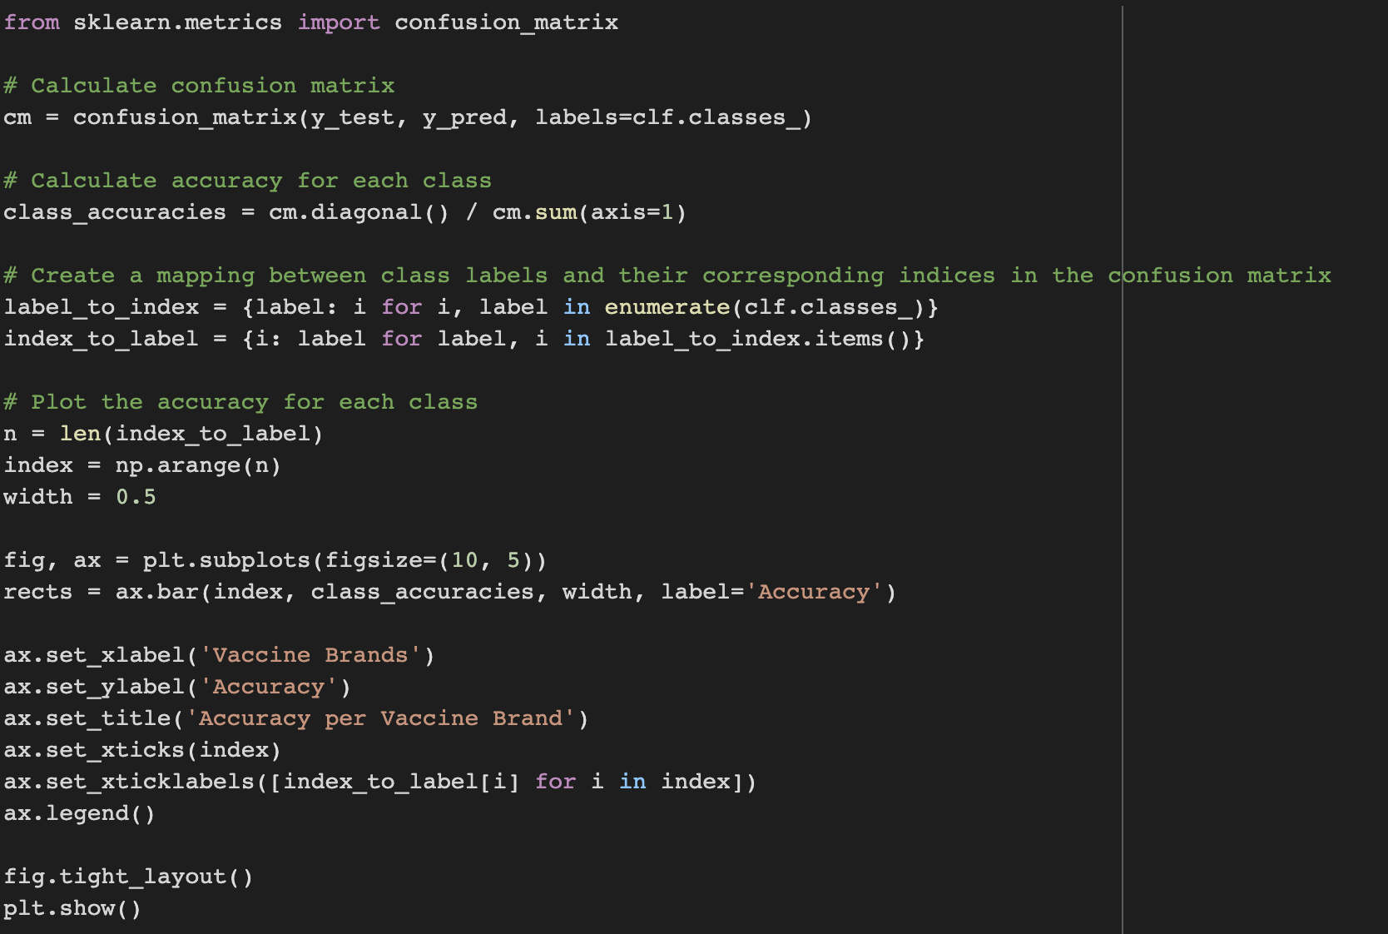
Evaluate and visualize the results
STEPS
Calculate confusion matrix
Calculate accuracy for each class
Create a mapping between class labels and their corresponding indices in the confusion matrix
The code performs classification and evaluates the accuracy for each vaccine brand using a confusion matrix and plots the result in a bar chart. It also uses the Matplotlib library to add axis labels, a title, and a legend to the plot.

Slide 25
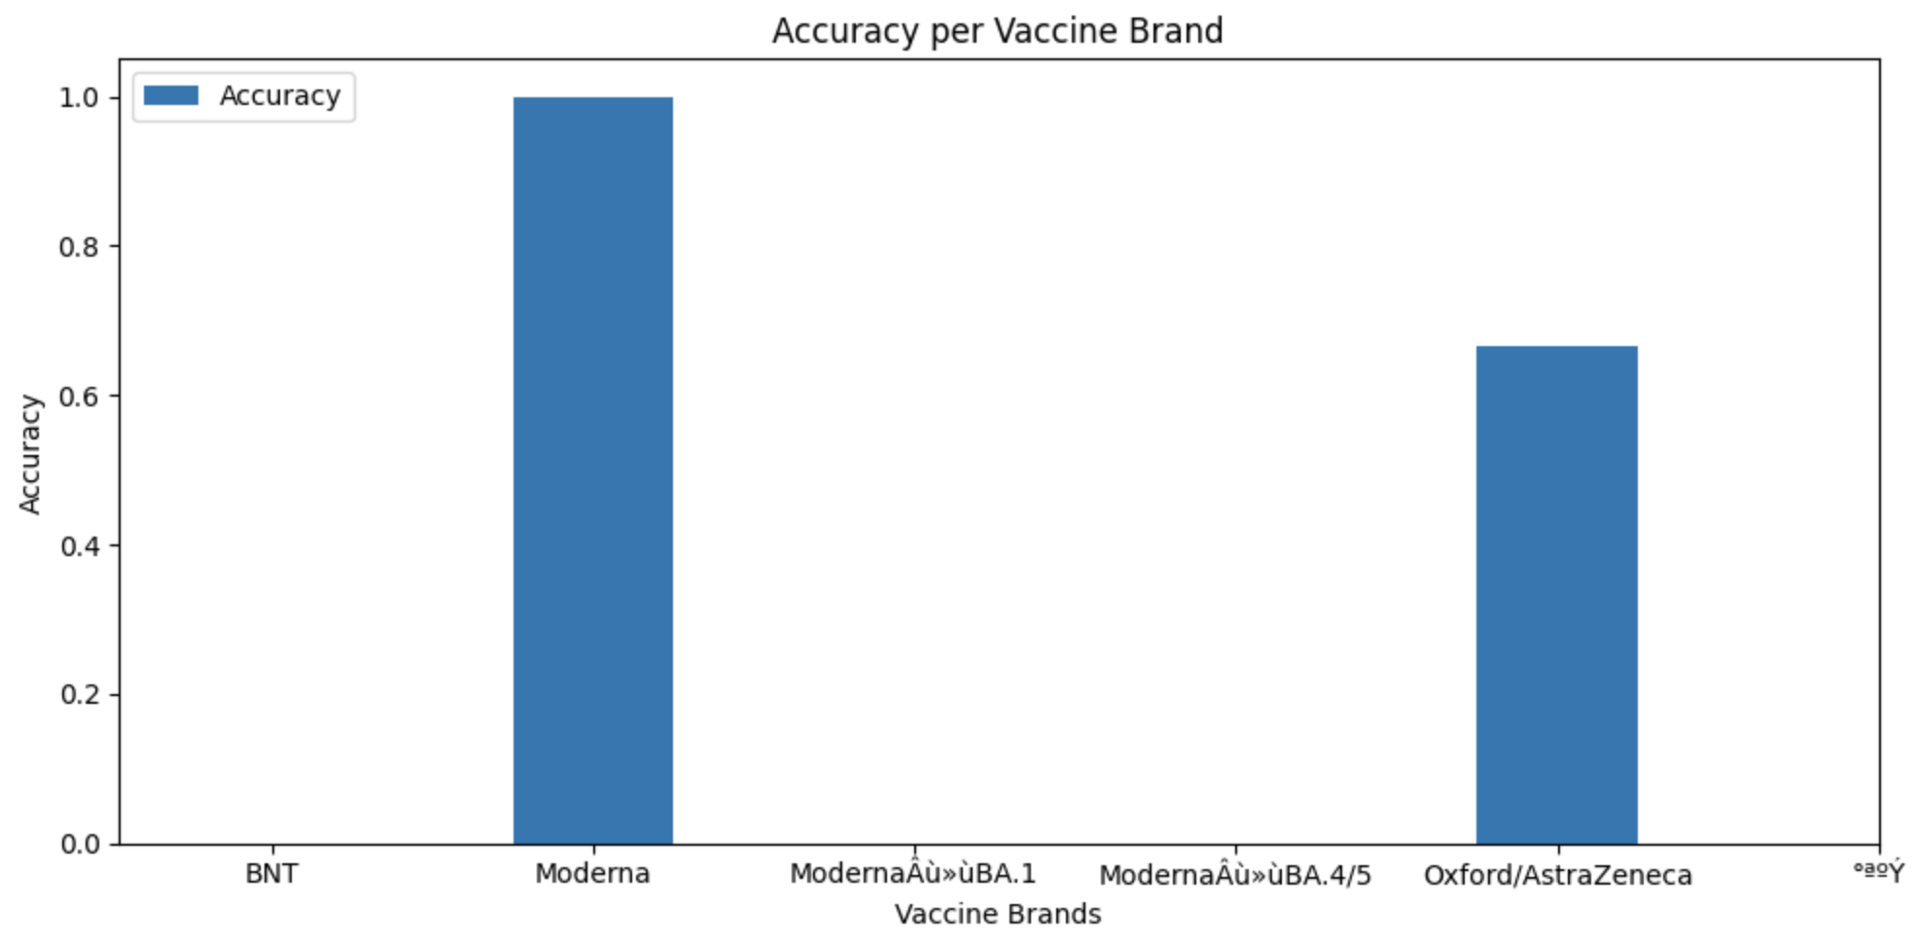
Evaluate and visualize the results-Results
accuracy for each vaccine brand using a bar chart

Slide 26
5
Results

Slide 27

Word Cloud

Slide 28
6
Conclusions & Next Step

Slide 29
Conclusion of predict rating
1.
overall accuracy of the model is 54.55%.
2.
model's accuracy varies greatly between different vaccine brands.
3.
model can be improved by addressing class imbalance and collecting more data
4.
Experimenting with different models and techniques can improve the model's performance.

Slide 30
Conclusion of Word Cloud
Top Keyword
Second-tier Keyword

Slide 31
References
https://covid-19.nchc.org.tw/dt_002-csse_covid_19_daily_reports_vaccine_city2.php
https://github.com/APCLab/jieba-tw
https://github.com/fxsjy/jieba/blob/master/extra_dict/stop_words.txt

Slide 32
Thank You !!!

